Slide 1
Exam 2
David Quigley
CSCI 5622
2021 Fall

Slide 2
Tuesday

Slide 3
Course Logistics
Problem Set 5 Due Thursday 12/9
Project 4: Final Report is now posted (12/13 @ 4:30 PM)
Exam 2: Thursday 12/2

Slide 4
Exam Logistics
(Same as Exam 1)
On Canvas
75 Minute Timer (+ accommodations)
Support Window (in-person and via Zoom at Lecture Channel)
During Lecture Time (3:55 – 5:10) + extra for accommodations

Slide 5
Exam Expectations
(Same as Exam 1)
Multiple Choice / Matching / Short Answer
Approximately 4 – 5
Calculations / Problem Solving
Approximately 3 to 4
Four-Function Calculator only (i.e. no logs, e^x, etc. will be calculated. You may have to simplify to those terms.)
Week 8 (starting with Neural Nets) Through Week 12 (Ethics)

Slide 6
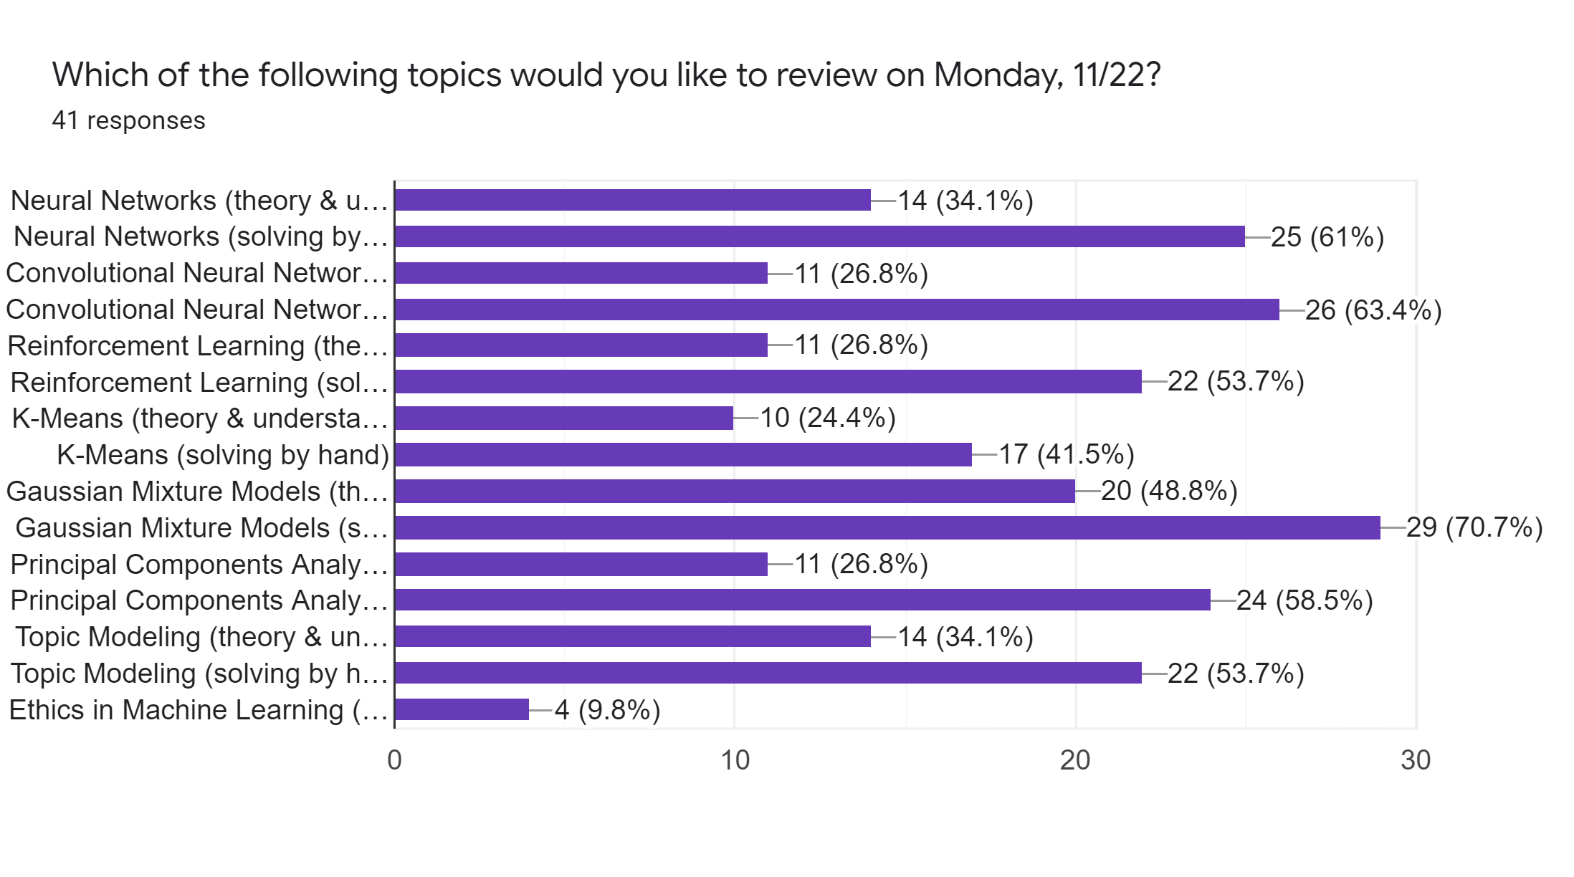

Poll Results

Slide 7
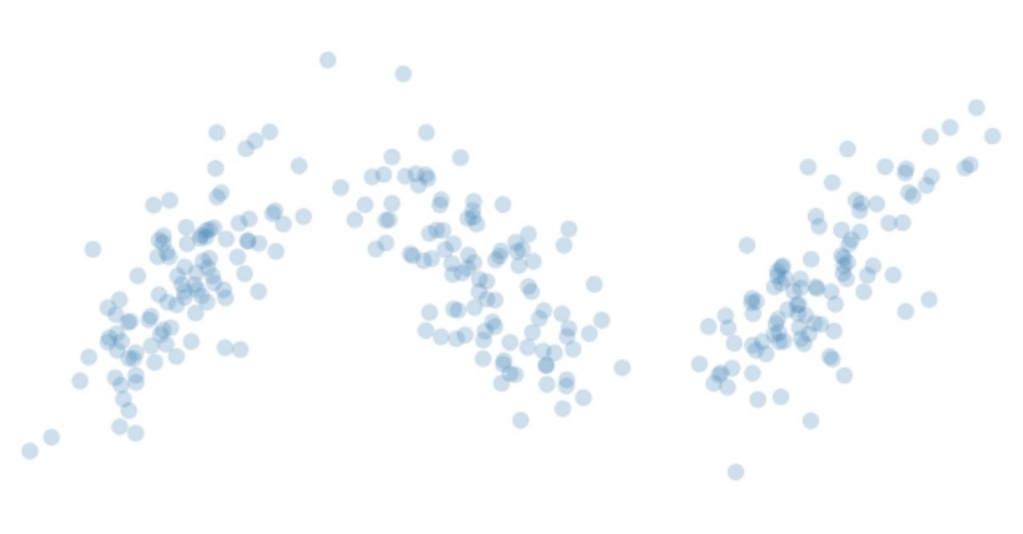
Clustering Objective - Start

Slide 8
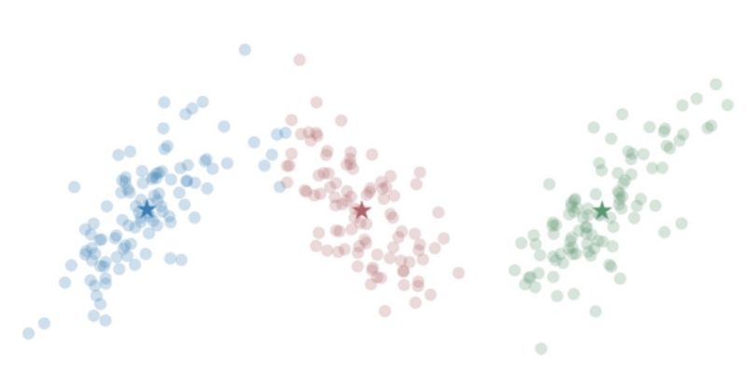
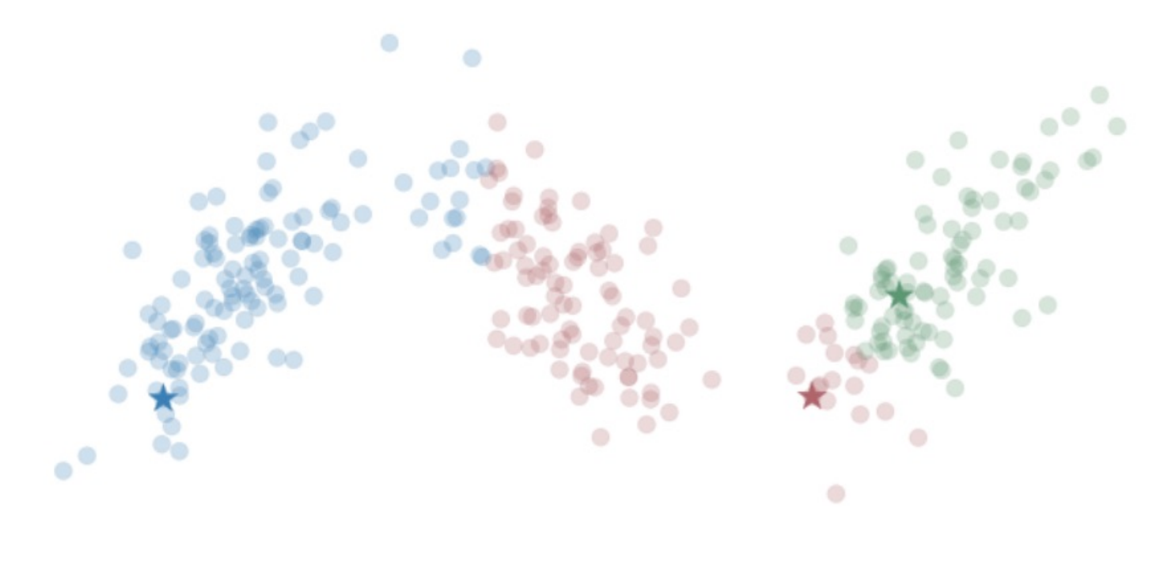
Clustering Objective - End

Slide 9
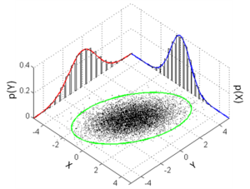
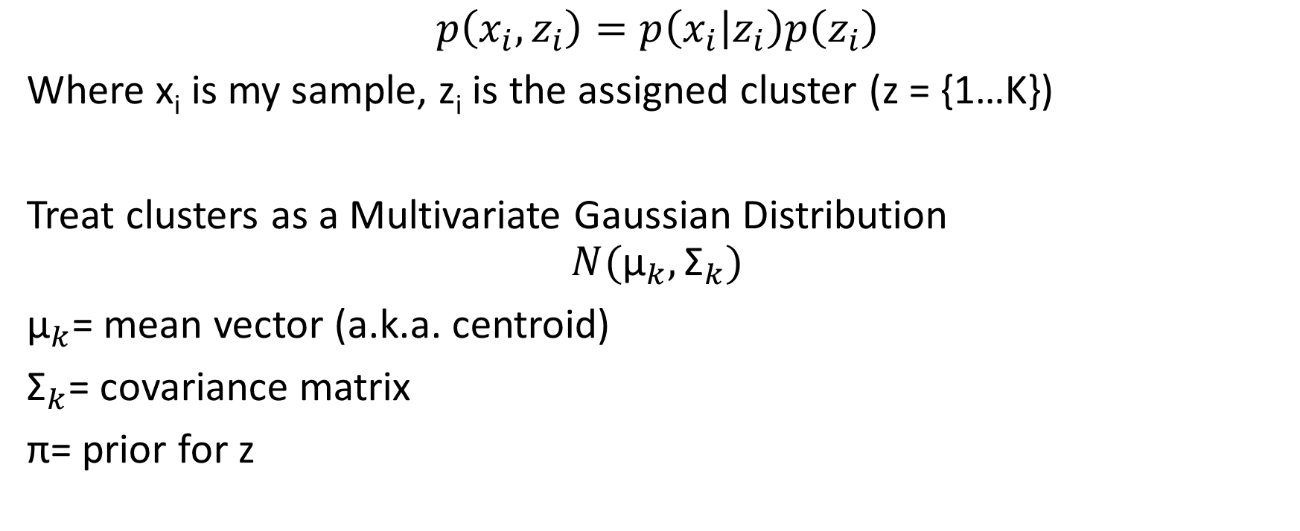
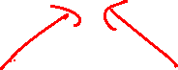
Generalizing K Means – Gaussian Distribution
$$p\left(x_{i},z_{i}\right)=p\left(x_{i} | z_{i}\right)p\left(z_{i}\right)$$
Where x_{i} is my sample, z_{i} is the assigned cluster (z = {1…K})
Treat clusters as a Multivariate Gaussian Distribution
$$N({\text{μ}}_{k},{\text{Σ}}_{k})$$
${\text{μ}}_{k}$= mean vector (a.k.a. centroid)
${\text{Σ}}_{k}$= covariance matrix
$\text{π}$= prior for z
Notes:
https://en.wikipedia.org/wiki/Multivariate_normal_distribution

Slide 10
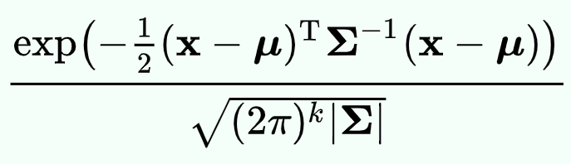
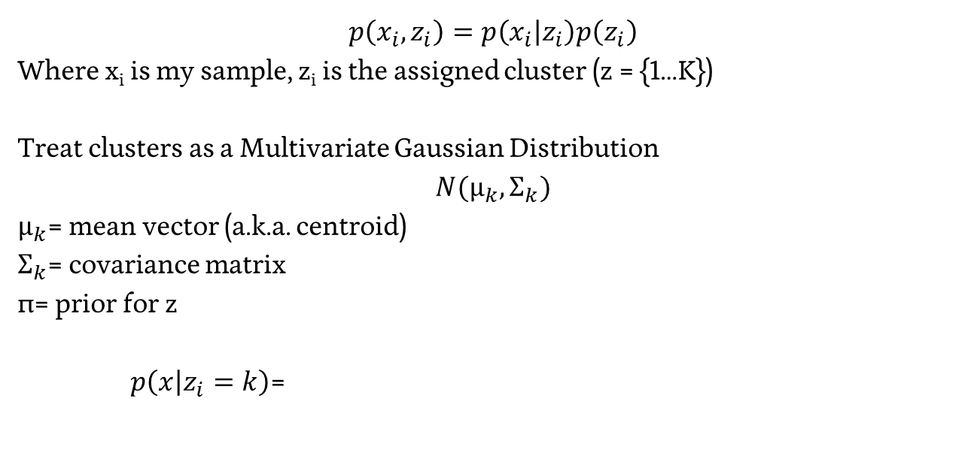

Generalizing K Means – Gaussian Distribution
$$p\left(x_{i},z_{i}\right)=p\left(x_{i} | z_{i}\right)p\left(z_{i}\right)$$
Where x_{i} is my sample, z_{i} is the assigned cluster (z = {1…K})
Treat clusters as a Multivariate Gaussian Distribution
$$N({\text{μ}}_{k},{\text{Σ}}_{k})$$
${\text{μ}}_{k}$= mean vector (a.k.a. centroid)
${\text{Σ}}_{k}$= covariance matrix
$\text{π}$= prior for z
$p\left(x | z_{i}=k\right)$=
Notes:
https://en.wikipedia.org/wiki/Multivariate_normal_distribution

Slide 11
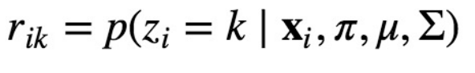
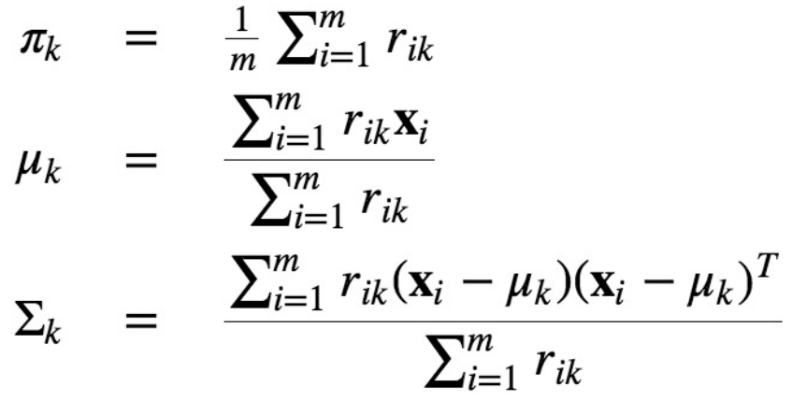
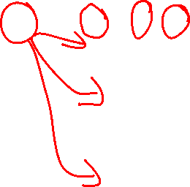
Gaussian Mixture Model – Expectation Maximization
Hold Z fixed, maximize our variables

Slide 12
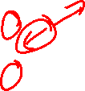
Given:
Centroids, Covariance, Priors for multiple clusters
Compute Cluster Assignment for points (max probability)

Slide 13
Generalizing K Means – Gaussian Distribution
$$p\left(x_{i},z_{i}\right)=p\left(x_{i} | z_{i}\right)p\left(z_{i}\right)$$
Where x_{i} is my sample, z_{i} is the assigned cluster (z = {1…K})
Treat clusters as a Multivariate Gaussian Distribution
$$N({\text{μ}}_{k},{\text{Σ}}_{k})$$
${\text{μ}}_{k}$= mean vector (a.k.a. centroid)
${\text{Σ}}_{k}$= covariance matrix
$\text{π}$= prior for z
$p\left(x | z_{i}=k\right)$=
Notes:
https://en.wikipedia.org/wiki/Multivariate_normal_distribution

Slide 14
Given:
Centroids, Covariance, Priors for multiple clusters
Compute Cluster Assignment for points (max probability)
*Compute easily calculatable portions of the probability

Slide 15

Given:
Cluster Assignment for points
Compute Centroid, Covariance, Prior for clusters

Slide 16
Gaussian Mixture Model – Expectation Maximization
Hold Z fixed, maximize our variables

Slide 17
Given:
Cluster Assignment for points, previous Centroid, Covariance, Prior
Compute updated (maximized) Centroid, Covariance, Prior for clusters

Slide 18
Given:
Cluster Assignment for points, previous Centroid, Covariance, Prior * (or just probability of assignment)
Compute updated (maximized) Centroid, Covariance, Prior for clusters

Slide 19
Poll Results

Slide 20
Basic Feed-Forward Neural Networks
1
1
b¹
b²
Every element of a layer is connected to every element of the following layer
Ordering, neighboring doesn’t matter…
Y₁
X₁
Y₂
X₂
W¹
W²

Slide 21
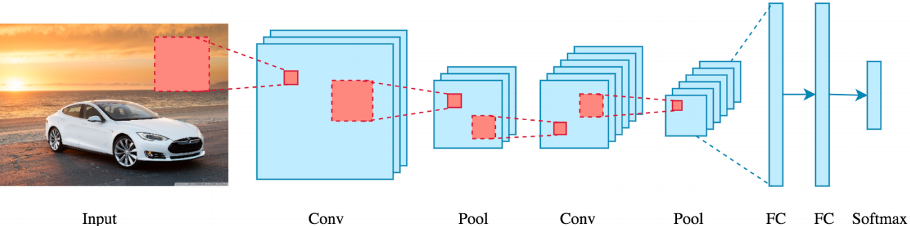
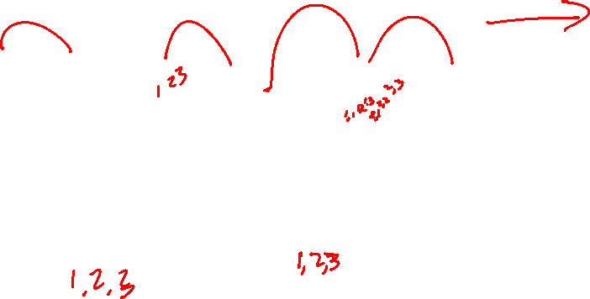
Convolution + Pooling

Slide 22
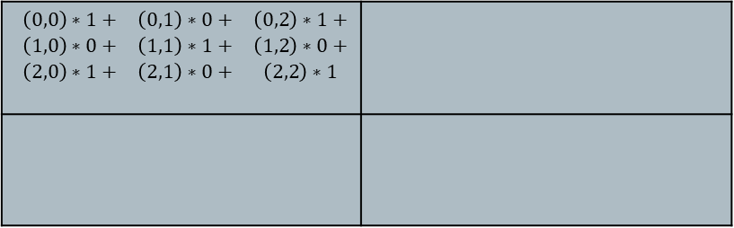
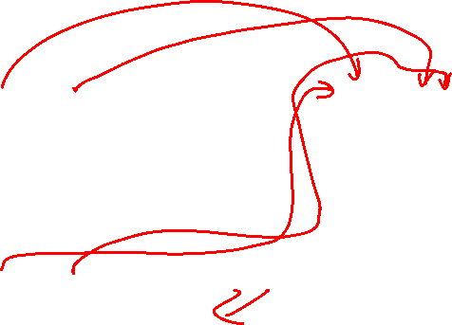
Convolution
Initial Matrix Output Matrix
Convolution Matrix
20 | 20 | 45 | 200
18 | 20 | 125 | 240
35 | 125 | 245 | 245
145 | 250 | 240 | 240
$$\begin{matrix}\left(0,0\right)∗1+ & \left(0,1\right)∗0+ & \left(0,2\right)∗1+ \\ \left(1,0\right)∗0+ & \left(1,1\right)∗1+ & \left(1,2\right)∗0+ \\ \left(2,0\right)∗1+ & \left(2,1\right)∗0+ & \left(2,2\right)∗1\end{matrix}$$
1 | 0 | 1
0 | 1 | 0
1 | 0 | 1

Slide 23
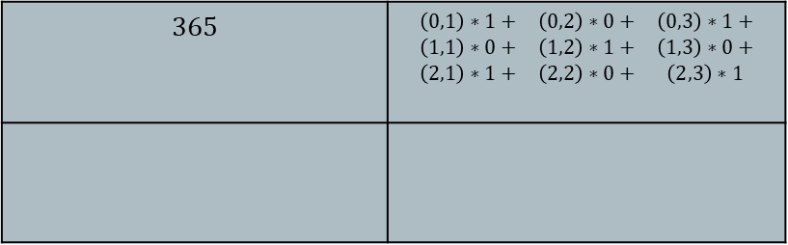
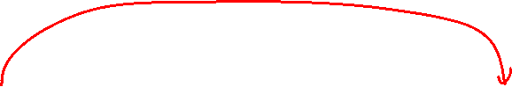
Convolution
Initial Matrix Output Matrix
Convolution Matrix
20 | 20 | 45 | 200
18 | 20 | 125 | 240
35 | 125 | 245 | 245
145 | 250 | 240 | 240
$$365$$ | $$\begin{matrix}\left(0,1\right)∗1+ & \left(0,2\right)∗0+ & \left(0,3\right)∗1+ \\ \left(1,1\right)∗0+ & \left(1,2\right)∗1+ & \left(1,3\right)∗0+ \\ \left(2,1\right)∗1+ & \left(2,2\right)∗0+ & \left(2,3\right)∗1\end{matrix}$$
1 | 0 | 1
0 | 1 | 0
1 | 0 | 1

Slide 24
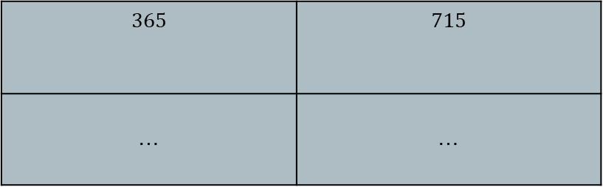
Convolution
Initial Matrix Output Matrix
Convolution Matrix
20 | 20 | 45 | 200
18 | 20 | 125 | 240
35 | 125 | 245 | 245
145 | 250 | 240 | 240
$$365$$ | $$715$$
… | …
1 | 0 | 1
0 | 1 | 0
1 | 0 | 1

Slide 25
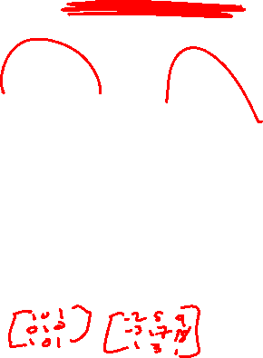
Convolution + Pooling

Slide 26
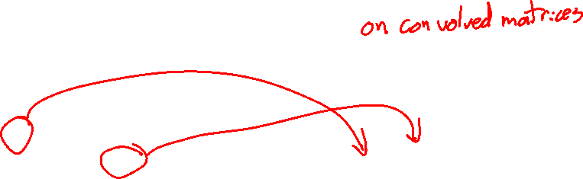
Pooling
Reduce Complexity by combining neighboring terms
e.g. max pool
20 | 20 | 45 | 200
18 | 20 | 125 | 240
35 | 125 | 245 | 245
145 | 250 | 240 | 240
20 | 240
250 | 245

Slide 27
Convolution + Pooling

Slide 28
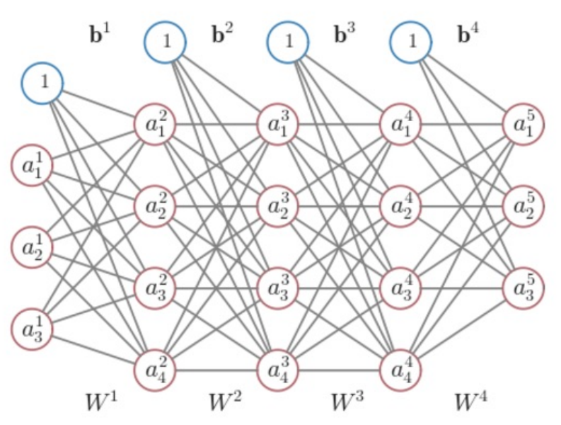
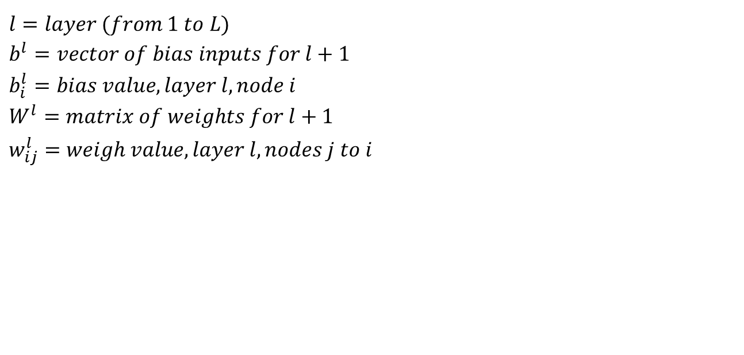
Neural Networks - Notation
$$l=layer (from 1 to L)$$
$$b^{l}=vector of bias inputs for l+1$$
$$b_{i}^{l}=bias value, layer l, node i$$
$$W^{l}=matrix of weights for l+1$$
$$w_{ij}^{l}=weigh value, layer l, nodes j to i$$

Slide 29
Improving Convolutions
SGD with Back Propagation
Details of implementation are beyond this course

Slide 30
Poll Results

Slide 31
Neural Networks

Slide 32

Neural Networks - Notation
$$l=layer (from 1 to L)$$
$$b^{l}=vector of bias inputs for l+1$$
$$b_{i}^{l}=bias value, layer l, node i$$
$$W^{l}=matrix of weights for l+1$$
$$w_{ij}^{l}=weigh value, layer l, nodes j to i$$

Slide 33
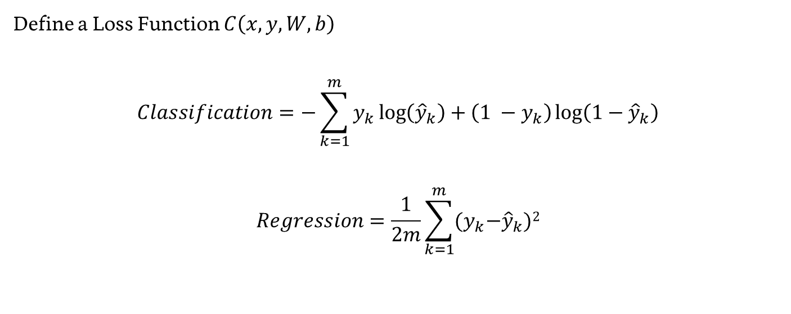
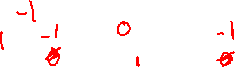
Neural Networks – Learning the Weights
Define a Loss Function $C\left(x,y,W,b\right)$
$$Classification=−\sum_{k=1}^{m}{y_{k}\log\left({\hat{y}}_{k}\right)+\left(1 −y_{k}\right)\log\left(1−{\hat{y}}_{k}\right)}$$
$$Regression=\frac{1}{2m}\sum_{k=1}^{m}{{(y}_{k}−{\hat{y}}_{k})2}$$

Slide 34
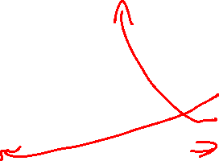
Where We Are
1
1
b¹
b²
Feed-Forward Neural Network
Initialize Weights
SGD loop (for random example):
forward propagate for activations
backward propagate for derivatives
update weights
(Hidden Layer Activation = ???)
(Output Layer Activation = ???)
(Cost Function = ???)
-1
-1
-1
Z=
a=
1
1
Y₁
z=
a=
X₁
-2
Truth =
Cost =
-2
2
-3
z=
a=
-1
1
X₂
2
2
3
z=
a=
3
W¹
W²

Slide 35
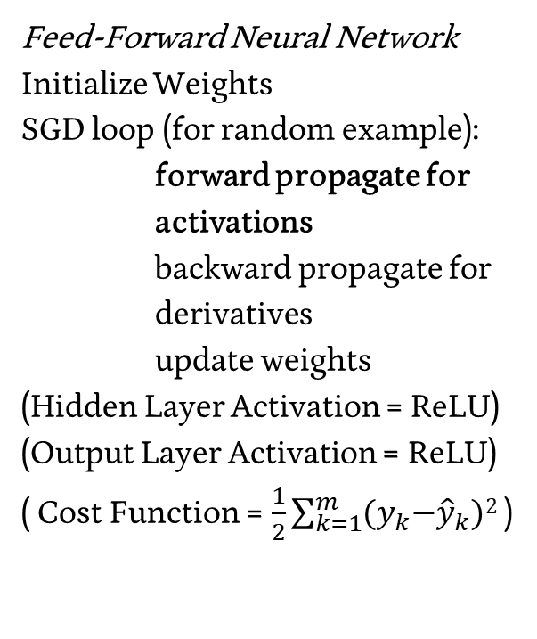
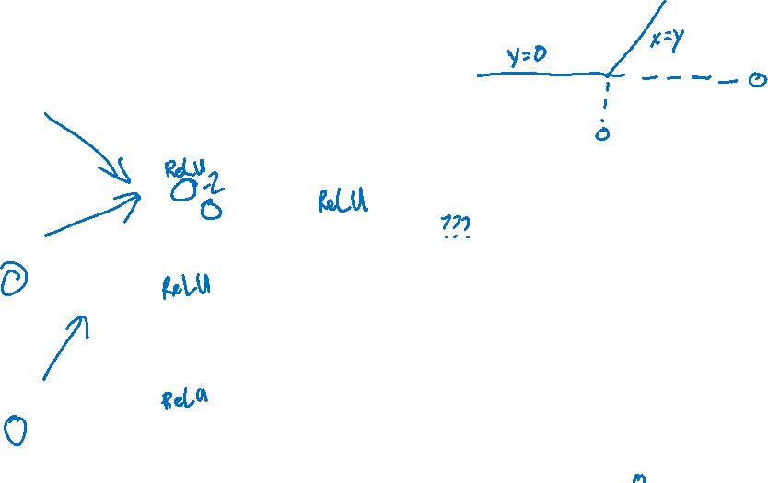
Where We Are
1
1
b¹
b²
Feed-Forward Neural Network
Initialize Weights
SGD loop (for random example):
forward propagate for activations
backward propagate for derivatives
update weights
(Hidden Layer Activation = ReLU)
(Output Layer Activation = ReLU)
( Cost Function = $\frac{1}{2}\sum_{k=1}^{m}{{(y}_{k}−{\hat{y}}_{k})2}$ )
-1
-1
-1
Z=
a=
1
1
Y₁
z=
a=
X₁
-2
Truth =
Cost =
-2
2
-3
z=
a=
-1
1
X₂
2
2
3
z=
a=
3
W¹
W²

Slide 36
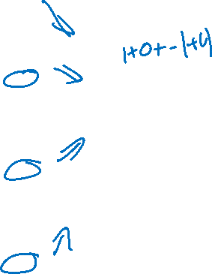
Where We Are
1
1
b¹
b²
Feed-Forward Neural Network
Initialize Weights
SGD loop (for random example):
forward propagate for activations
backward propagate for derivatives
update weights
(Hidden Layer Activation = ReLU)
(Output Layer Activation = ReLU)
( Cost Function = $\frac{1}{2}\sum_{k=1}^{m}{{(y}_{k}−{\hat{y}}_{k})2}$ )
-1
-1
-1
Z=-2
a=0
1
1
Y₁
z=2
a=2
X₁
-2
Truth = 4.2
Cost = 2.42
-2
2
-3
z=1
a=1
-1
1
X₂
2
2
3
z=2
a=2
3
W¹
W²

Slide 37
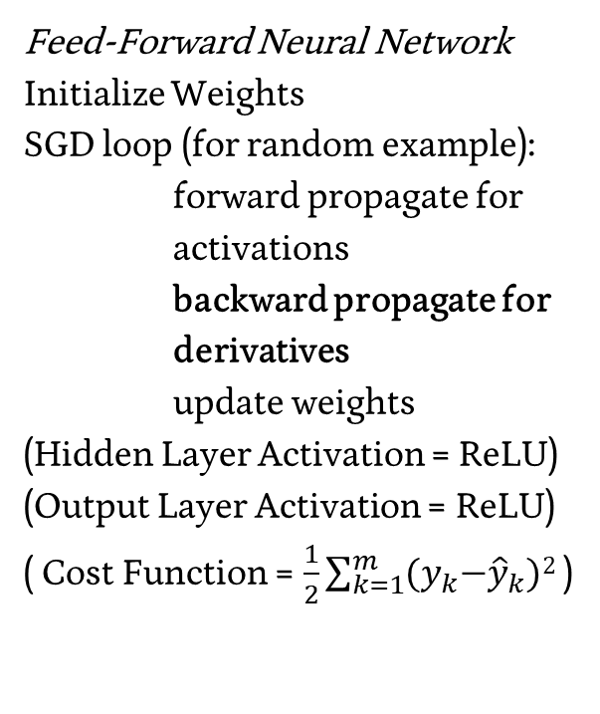
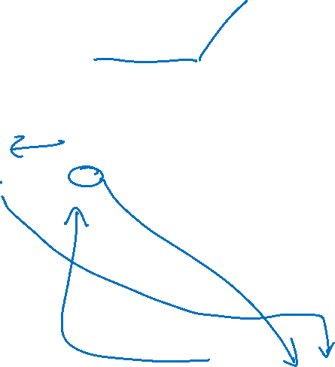
Where We Are
1
1
b¹
b²
Feed-Forward Neural Network
Initialize Weights
SGD loop (for random example):
forward propagate for activations
backward propagate for derivatives
update weights
(Hidden Layer Activation = ReLU)
(Output Layer Activation = ReLU)
( Cost Function = $\frac{1}{2}\sum_{k=1}^{m}{{(y}_{k}−{\hat{y}}_{k})2}$ )
-1
-1
-1
Z=-2
a=0
1
1
Y₁
z=2
a=2
X₁
-2
Truth = 4.2
Cost = 2.42
-2
2
-3
z=1
a=1
-1
1
X₂
2
2
3
z=2
a=2
3
W¹
W²

Slide 38
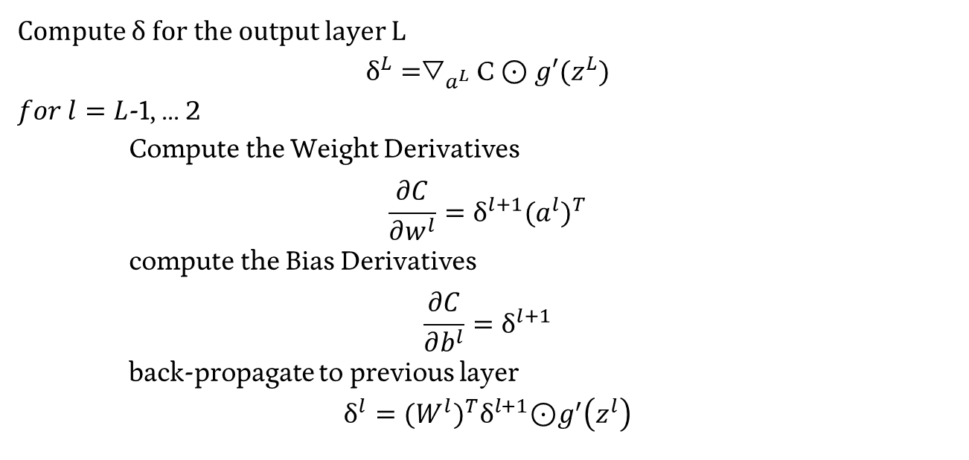
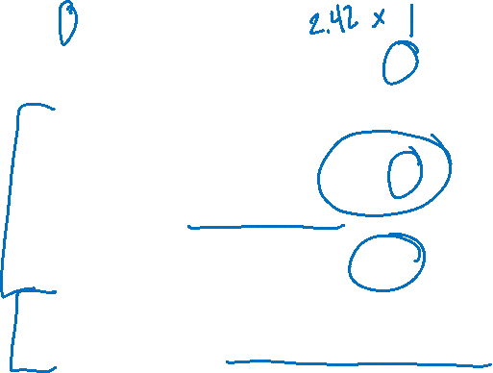
Back Propagation – General Algorithm
Compute $\text{δ}$ for the output layer L
$${\text{δ}}^{L}={\text{▽}}_{a^{L}}\text{C}\text{ ⊙} g′(z^{L})$$
$for l=L$-1, ... 2
Compute the Weight Derivatives
$$\frac{∂C}{∂w^{l}}={\text{δ}}^{l+1}{{(a}^{l})}^{T}$$
compute the Bias Derivatives
$$\frac{∂C}{∂b^{l}}={\text{δ}}^{l+1}$$
back-propagate to previous layer
$${\text{δ}}^{l}={(W^{l})}^{T}{\text{δ}}^{l+1}\text{⊙}g^{′}\left(z^{l}\right)$$

Slide 39
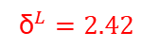
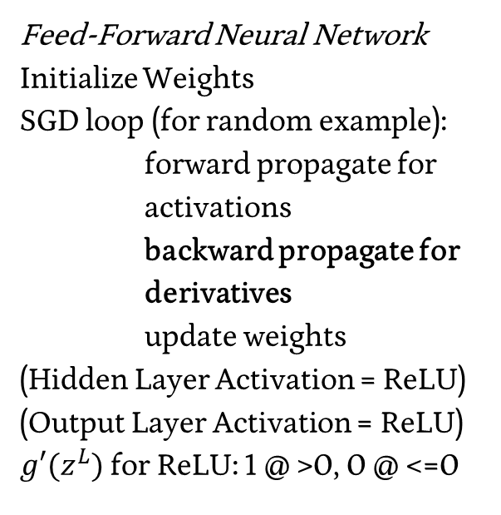
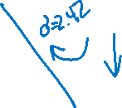
Where We Are
1
1
b¹
b²
$${\text{δ}}^{L}=2.42$$
Feed-Forward Neural Network
Initialize Weights
SGD loop (for random example):
forward propagate for activations
backward propagate for derivatives
update weights
(Hidden Layer Activation = ReLU)
(Output Layer Activation = ReLU) $g′(z^{L})$ for ReLU: 1 @ >0, 0 @ <=0
-1
-1
-1
Z=-2
a=0
1
1
Y₁
z=2
a=2
X₁
-2
Truth = 4.2
Cost = 2.42
-2
2
-3
z=1
a=1
-1
1
X₂
2
2
3
z=2
a=2
3
W¹
W²

Slide 40
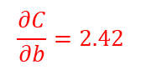
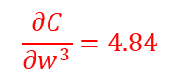
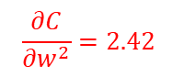
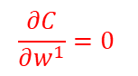
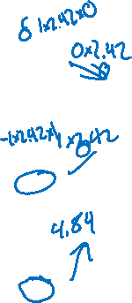
Where We Are
1
1
$$\frac{∂C}{∂b}=2.42$$
b¹
b²
$${\text{δ}}^{L}=2.42$$
Feed-Forward Neural Network
Initialize Weights
SGD loop (for random example):
forward propagate for activations
backward propagate for derivatives
update weights
(Hidden Layer Activation = ReLU)
(Output Layer Activation = ReLU) $g′(z^{L})$ for ReLU: 1 @ >0, 0 @ <=0
-1
-1
-1
Z=-2
a=0
1
1
Y₁
z=2
a=2
X₁
-2
Truth = 4.2
Cost = 2.42
-2
$$\frac{∂C}{∂w^{1}}=0$$
2
-3
z=1
a=1
-1
$$\frac{∂C}{∂w^{2}}=2.42$$
1
X₂
2
2
z=2
a=2
$$\frac{∂C}{∂w^{3}}=4.84$$
3
3
W¹
W²

Slide 41
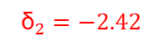
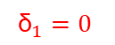
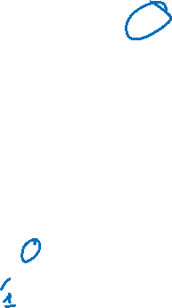
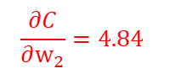
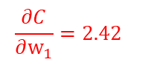
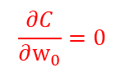
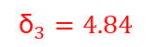
Where We Are
1
1
$$\frac{∂C}{∂b}=2.42$$
b¹
b²
$${\text{δ}}^{L}=2.42$$
Feed-Forward Neural Network
Initialize Weights
SGD loop (for random example):
forward propagate for activations
backward propagate for derivatives
update weights
(Hidden Layer Activation = ReLU)
(Output Layer Activation = ReLU) $g′(z^{L})$ for ReLU: 1 @ >0, 0 @ <=0
-1
$${\text{δ}}_{1}=0$$
-1
-1
Z=-2
a=0
1
1
Y₁
z=2
a=2
X₁
-2
$$\frac{∂C}{∂{\text{w}}_{0}}=0$$
Truth = 4.2
Cost = 2.42
-2
$${\text{δ}}_{2}=−2.42$$
2
-3
z=1
a=1
-1
$$\frac{∂C}{∂{\text{w}}_{1}}=2.42$$
1
X₂
2
$${\text{δ}}_{3}=4.84$$
2
z=2
a=2
$$\frac{∂C}{∂{\text{w}}_{2}}=4.84$$
3
3
W¹
W²

Slide 42
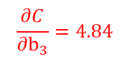



Where We Are
1
$$\frac{∂C}{∂{\text{b}}_{1}}=0$$
1
$$\frac{∂C}{∂b}=2.42$$
b¹
b²
$${\text{δ}}^{L}=2.42$$
Feed-Forward Neural Network
Initialize Weights
SGD loop (for random example):
forward propagate for activations
backward propagate for derivatives
update weights
(Hidden Layer Activation = ReLU)
(Output Layer Activation = ReLU) $g′(z^{L})$ for ReLU: 1 @ >0, 0 @ <=0
-1
$${\text{δ}}_{1}=0$$
-1
-1
Z=-2
a=0
1
$$\frac{∂C}{∂{\text{b}}_{2}}=−2.42$$
1
Y₁
z=2
a=2
X₁
-2
$$\frac{∂C}{∂{\text{w}}_{0}}=0$$
Truth = 4.2
Cost = 2.42
-2
$${\text{δ}}_{2}=−2.42$$
2
-3
z=1
a=1
-1
$$\frac{∂C}{∂{\text{b}}_{3}}=4.84$$
$$\frac{∂C}{∂{\text{w}}_{1}}=2.42$$
1
X₂
2
$${\text{δ}}_{3}=4.84$$
2
z=2
a=2
$$\frac{∂C}{∂{\text{w}}_{2}}=4.84$$
3
3
W¹
W²

Slide 43








$$\frac{∂C}{∂b}=\left\langle 0 | −2.42 | 4.84\right\rangle$$
1
1
$$\frac{∂C}{∂b}=2.42$$
b¹
b²
$${\text{δ}}^{L}=2.42$$
Feed-Forward Neural Network
Initialize Weights
SGD loop (for random example):
forward propagate for activations
backward propagate for derivatives
update weights
(Hidden Layer Activation = ReLU)
(Output Layer Activation = ReLU) $g′(z^{L})$ for ReLU: 1 @ >0, 0 @ <=0
-1
$${\text{δ}}_{1}=0$$
-1
-1
Z=-2
a=0
1
$$\frac{∂C}{∂{\text{w}}_{11}}=0$$
1
Y₁
z=2
a=2
X₁
-2
$$\frac{∂C}{∂{\text{w}}_{1}}=0$$
Truth = 4.2
Cost = 2.42
$$\frac{∂C}{∂{\text{w}}_{12}}=−4.84$$
-2
$${\text{δ}}_{2}=−2.42$$
2
-3
z=1
a=1
-1
$$\frac{∂C}{∂{\text{w}}_{13}}=9.68$$
$$\frac{∂C}{∂{\text{w}}_{2}}=2.42$$
1
X₂
2
$${\text{δ}}_{3}=4.84$$
2
z=2
a=2
$$\frac{∂C}{∂{\text{w}}_{3}}=4.84$$
3
3
W¹
W²

Slide 44





$$\frac{∂C}{∂{\text{w}}_{1}}=\left\langle 0 | −4.84 | 9.62\right\rangle$$
$$\frac{∂C}{∂b}=\left\langle 0 | −2.42 | 4.84\right\rangle$$
1
1
$$\frac{∂C}{∂b}=2.42$$
b¹
b²
$${\text{δ}}^{L}=2.42$$
Feed-Forward Neural Network
Initialize Weights
SGD loop (for random example):
forward propagate for activations
backward propagate for derivatives
update weights
(Hidden Layer Activation = ReLU)
(Output Layer Activation = ReLU) $g′(z^{L})$ for ReLU: 1 @ >0, 0 @ <=0
-1
$${\text{δ}}_{1}=0$$
-1
-1
Z=-2
a=0
1
1
Y₁
z=2
a=2
X₁
-2
$$\frac{∂C}{∂{\text{w}}_{0}}=0$$
Truth = 4.2
Cost = 2.42
-2
$${\text{δ}}_{2}=−2.42$$
2
-3
z=1
a=1
-1
$$\frac{∂C}{∂{\text{w}}_{21}}=0$$
$$\frac{∂C}{∂{\text{w}}_{1}}=2.42$$
1
$$\frac{∂C}{∂{\text{w}}_{22}}=−7.26$$
X₂
2
$${\text{δ}}_{3}=4.84$$
2
z=2
a=2
$$\frac{∂C}{∂{\text{w}}_{2}}=4.84$$
3
3
$$\frac{∂C}{∂{\text{w}}_{23}}=14.52$$
W¹
W²

Slide 45
Poll Results

Slide 46

Principal Components – A different objective
What is unique?
What makes an X?

Slide 47

Step 1 – Build a Linear Model Approximation
Implementation details are outlined in ESL Textbook

Slide 48

Step 1 – Build a Linear Model Approximation
Implementation details are outlined in ESL Textbook

Slide 49

Step 1 – Build a Linear Model Approximation
End with the Singular Value Decomposition
$$X = UDV^{T}$$
X = our observations*
N (number of points) by p (dimensions)
U = orthog. matrix, left singular vector columns
N by p
D = diagonal matrix, singular values
p by p
V^{T} = orthog. matrix, right singular vect. columns
p by p
*obs. have been re-centered to a new origin

Slide 50

Step 2 – Extract the q principal components you seek
$X_{q} = U_{q}D_{q}$

Slide 51


Kernel PCA

Slide 52
Poll Results

Slide 53


Topic Modeling
Clustering Technique
Associate similar documents
Example: Topics in Science

Slide 54
NLP Primer – Documents into Features
Cleaning & Preparing Text
- Tokenization
- Removing Unhelpful Words
- Lemmatization & Stemming

Slide 55


NLP – Analysis Approaches
Bag-of-words – each document is just a collection of words, dropping all reference to order, etc.
N-Gram Models – Each set of N words is treated as an entry

Slide 56


Topic Modeling – Vectors to Matrix
Words array for each entry → <Documents> X <Words> Matrix
Documents
0 1 … n-1 n
Words $\begin{matrix}\begin{matrix}base \\ bat\end{matrix} \\ … \\ \begin{matrix}cause \\ missile\end{matrix}\end{matrix}$ $\left[\begin{matrix}\begin{matrix}1 & 2 \\ 0 & 5\end{matrix} & ⋯ & \begin{matrix}9 & 0 \\ 0 & 0\end{matrix} \\ ⋮ & ⋱ & ⋮ \\ \begin{matrix}8 & 6 \\ 0 & 4\end{matrix} & ⋯ & \begin{matrix}1 & 3 \\ 0 & 4\end{matrix}\end{matrix}\right]$

Slide 57


Adjusting the Matrix – TF-IDF
term frequency-inverse document frequency
Notes:
https://medium.com/nanonets/topic-modeling-with-lsa-psla-lda-and-lda2vec-555ff65b0b05

Slide 58


Topic Modeling – Vectors to Matrix
<Documents> X <Words> Matrix
Documents
0 1 … n-1 n
Words (TF-IDF) $\begin{matrix}\begin{matrix}base \\ bat\end{matrix} \\ … \\ \begin{matrix}cause \\ missile\end{matrix}\end{matrix}$ $\left[\begin{matrix}\begin{matrix}1.2 & .004 \\ 0 & .01\end{matrix} & ⋯ & \begin{matrix}78.2 & 0 \\ 0 & 0\end{matrix} \\ ⋮ & ⋱ & ⋮ \\ \begin{matrix}99.3 & .013 \\ 0 & .009\end{matrix} & ⋯ & \begin{matrix}3.2 & 7.5 \\ 0 & 9.2\end{matrix}\end{matrix}\right]$

Slide 59

Topic Modeling – Matrix to Topics
Matrix Representation of Documents & Words
Think of this as a generative process – Words → Topics → Documents
Docs X Words Topics X Words Topics Docs X Topics

Slide 60

Topic Modeling - Example
Given these tweets:
[i, lov, machin, learn]
[machin, learn, stink]
[lov, learn, learn, scien]
Make a Bag-of-Words Documents X Words matrix
Make a Bag-of-Words Documents X Word TF-IDF matrix
(Singular Value Decomposition is beyond what I can ask)

Slide 61

Topic Modeling - Example
Given these tweets:
[i, lov, machin, learn]
[machin, learn, stink]
[lov, learn, learn, scien]
Make a Bag-of-Words Documents X Words matrix
Make a Bag-of-Words Documents X Word TF-IDF matrix
(Singular Value Decomposition is beyond what I can ask)
0 1 2
i
lov
machin
learn
stink
scien

Slide 62

Topic Modeling - Example
Given these tweets:
[i, lov, machin, learn]
[machin, learn, stink]
[lov, learn, learn, scien]
Make a Bag-of-Words Documents X Words matrix
Make a Bag-of-Words Documents X Word TF-IDF matrix
(Singular Value Decomposition is beyond what I can ask)
0 1 2
i
lov
machin
learn
stink
scien
$$\left[\begin{matrix}\begin{matrix}1 \\ 1 \\ \begin{matrix}1 \\ 1 \\ \begin{matrix}0 \\ 0\end{matrix}\end{matrix}\end{matrix} & \begin{matrix}0 \\ 0 \\ \begin{matrix}1 \\ 1 \\ \begin{matrix}1 \\ 0\end{matrix}\end{matrix}\end{matrix} & \begin{matrix}0 \\ 1 \\ \begin{matrix}0 \\ 2 \\ \begin{matrix}0 \\ 1\end{matrix}\end{matrix}\end{matrix}\end{matrix}\right]$$

Slide 63



Topic Modeling - Example
Given these tweets:
[i, lov, machin, learn]
[machin, learn, stink]
[lov, learn, learn, scien]
Make a Bag-of-Words Documents X Words matrix
Make a Bag-of-Words Documents X Word TF-IDF matrix
(Singular Value Decomposition is beyond what I can ask)
0 1 2
0 1 2
i
lov
machin
learn
stink
scien
$$\left[\begin{matrix}\begin{matrix}1 \\ 1 \\ \begin{matrix}1 \\ 1 \\ \begin{matrix}0 \\ 0\end{matrix}\end{matrix}\end{matrix} & \begin{matrix}0 \\ 0 \\ \begin{matrix}1 \\ 1 \\ \begin{matrix}1 \\ 0\end{matrix}\end{matrix}\end{matrix} & \begin{matrix}0 \\ 1 \\ \begin{matrix}0 \\ 2 \\ \begin{matrix}0 \\ 1\end{matrix}\end{matrix}\end{matrix}\end{matrix}\right]$$
i
lov
machin
learn
stink
scien
$$\left[\begin{matrix}\begin{matrix}1∗log⁡(3) \\ 1∗log⁡(1.5) \\ \begin{matrix}1∗\log{(1.5)} \\ 1 ∗log⁡(1) \\ \begin{matrix}0 \\ 0\end{matrix}\end{matrix}\end{matrix} & \begin{matrix}0 \\ 0 \\ \begin{matrix}1∗log⁡(1.5) \\ 1 ∗log⁡(1) \\ \begin{matrix}1∗log⁡(3) \\ 0\end{matrix}\end{matrix}\end{matrix} & \begin{matrix}0 \\ 1∗log⁡(1.5) \\ \begin{matrix}0 \\ 2 ∗log⁡(1) \\ \begin{matrix}0 \\ 1∗log⁡(3)\end{matrix}\end{matrix}\end{matrix}\end{matrix}\right]$$

Slide 64
Poll Results

Slide 65

Defining Our Problem Space
Agent – A decision-making entity
Environment – The space in which the Agent is making decisions
State (S) – The current status of the Environment
Goal – An eventual outcome sought by the Agent
Reward (R) – Intermediate measure of success/failure towards the Goal
Action (A) – The options available to the Agent to change the State

Slide 66


Markov Decision Processes
Notes:
http://incompleteideas.net/book/bookdraft2017nov5.pdf

Slide 67


Developing Q – Updating Value
Calculate out the probability of success or failure at each point
Notes:
https://www.cin.ufpe.br/~tfl2/artificial-intelligence-modern-approach.9780131038059.25368.pdf

Slide 68

Developing Q – Updating Value
Calculate out the probability of success or failure at each point
Notes:
https://www.cin.ufpe.br/~tfl2/artificial-intelligence-modern-approach.9780131038059.25368.pdf

Slide 69

Developing Q – Updating Policy
You can use this approach to feed back into your decision policies!
Notes:
https://www.cin.ufpe.br/~tfl2/artificial-intelligence-modern-approach.9780131038059.25368.pdf

Slide 70

Scale – Monte Carlo Estimation
Instead of mapping out the full probability space, let’s generate a bunch of sample uses of our policy (to end-state) and use the outcomes to determine value!
Notes:
https://thumbs.gfycat.com/BetterThankfulEnglishsetter-max-1mb.gif

